Slide 1

DLA hardware
Yi Li
2017/11/30

Slide 2
Outline
Performance/bandwidth Requirement for CNNs
Compression for bandwidth
Computing reduced for performance

Slide 3
Outline
Performance/bandwidth Requirement for CNNs
Compression for bandwidth
Computing reduced for performance

Slide 4
Performance/bandwidth Requirement for CNNs
 | Alexnet | GoogLeNet(v1) | Tiny YOLO | YOLO v2
MACs | 724M | 1.43G | 3.5G | 17.5G
Weight Num | 61M | 7M | 15.1M | 48.3M
Weight Size (16bits) | 122MByte | 14MByte | 30.2MByte | 96.6MByte
DDR bandwith | 9.6GBytes/4 | 9.6GBytes/4 | 9.6GBytes/4 | 9.6GBytes/4
MACs computing | 1024 | 1024 | 1024 | 1024
Embedded Freq | 600MHz | 600MHz | 600MHz | 600MHz
FPS (bandwith) | 20 | 171 | 79 | 25
FPS (computing) | 848 | 429 | 175 (actually 5 fps in sirius @800MHz) | 35

Slide 5
Performance/bandwidth Requirement for CNNs
Bandwidth
Computing
Sparsity

Slide 6
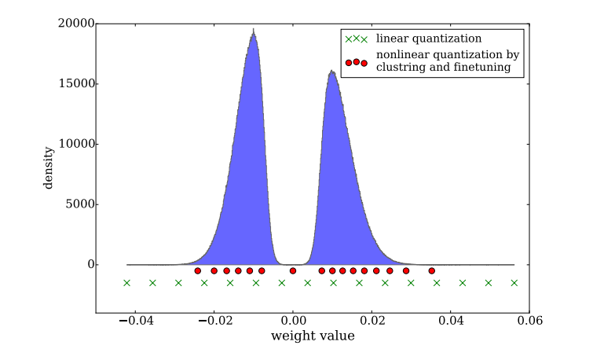
Performance/bandwidth Requirement for CNNs
Static (Weight): Quantization

Slide 7
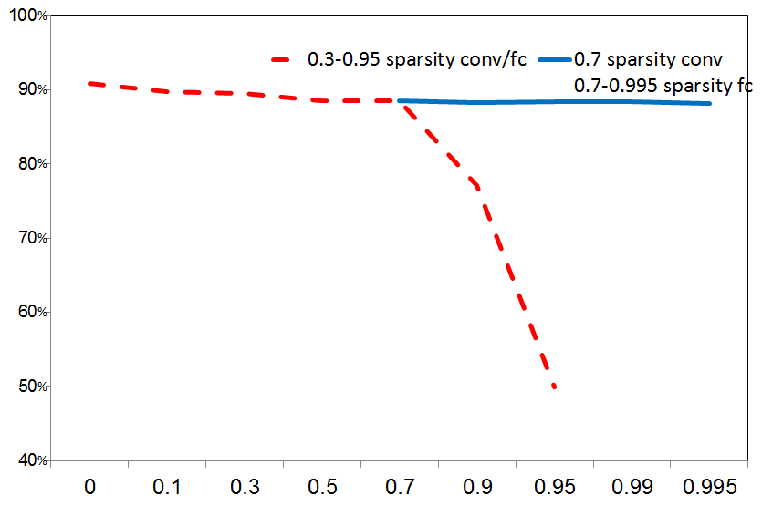
Performance/bandwidth Requirement for CNNs
Static (Weight): prune
Alexnet | conv1 | conv2 | conv3 | conv4 | conv5 | fc6 | fc7 | fc8
sparsity | 0.7 | 0.7 | 0.7 | 0.7 | 0.7 | 0.005 | 0.005 | 0.005

Slide 8
Performance/bandwidth Requirement for CNNs
Dynamic (feature map)
Alexnet | pool1 | pool2 | conv3 | conv4 | pool5 | fc6 | fc7
sparsity | 0.875 | 0.467 | 0.291 | 0.32 | 0.296 | 0.046 | 0.072

Slide 9
Outline
Performance/bandwidth Requirement for CNNs
Compression for bandwidth
Computing reduced for performance

Slide 10
Compression for bandwidth
Uncompressed
value | 1 | 0 | 2 | 3 | 0 | 0 | 0 | 0 | 4
Conventional compress
value | 1 | 2 | 3 | 4
indx | 0 | 2 | 3 | 8
Indx width is undetermined and large
Proposed compress
value | 1 | 2 | 3 | 0 | 4
Nxt nz dis | 1 | 0 | 3 | 0 | …
Indx width is determined (2bit or 4bit)

Slide 11
Compression for bandwidth
128bit
16bit x 8
8bit x 16
128bit
(16bit+4bit) x 6
(8bit+4bit) x 10
If sparsity = 0.005, compress ratio 16bit : 1/(0.005*8/6)=150
8bit: 1/(0.005*16/10)=125
If sparsity = 0.5, compress ratio 16bit : 1/(0.5*8/6)=1.5
8bit: 1/(0.5*16/10)=1.25

Slide 12
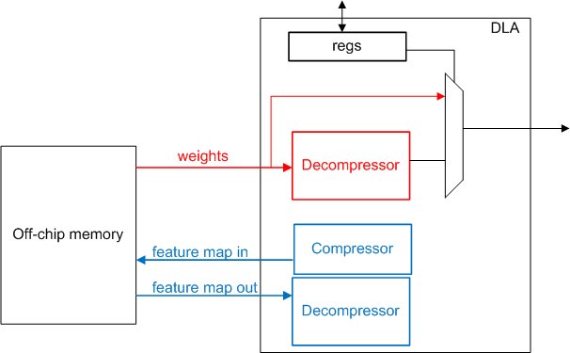
Compression for bandwidth

Slide 13
Outline
Performance/bandwidth Requirement for CNNs
Compression for bandwidth
Computing reduced for performance

Slide 14
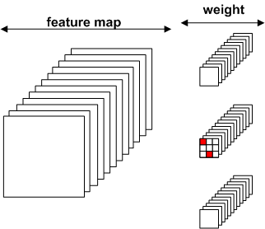
Computing reduced for performance
Static (Weight):
Need bright thought

Slide 15
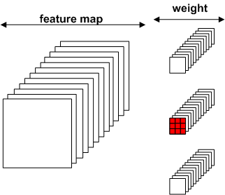
Computing reduced for performance
Static (Weight):
Generator can eliminate zero weight of input channel (granularity 16 )

Slide 16
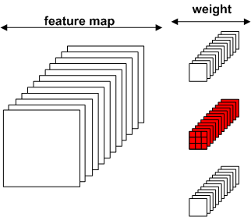
Computing reduced for performance
Static (Weight):
Generator can eliminate zero weight of output channel (granularity 16 )

Slide 17
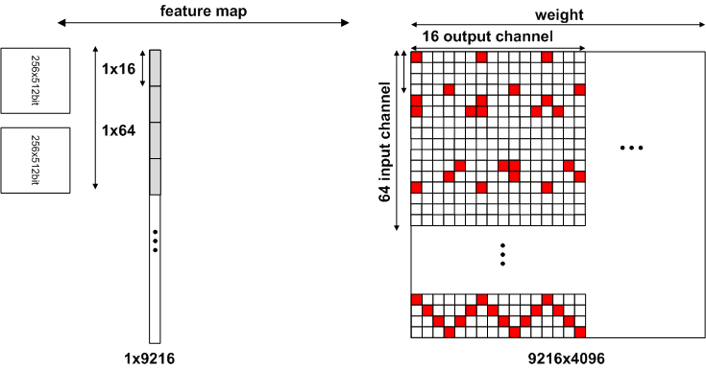
Computing reduced for performance
Dynamic (feature data):
How to skip zero value computing efficiently?

Slide 18
Computing reduced for performance
Dynamic (feature data):
Add 4bit/2bit in each mem for indicating next non-zero value

Slide 19
Computing reduced for performance
Dynamic (feature data):
Divide mem into small width

Slide 20
Computing reduced for performance
Dynamic (feature data):
PE width=16 | pool5 | fc6 | fc7
cycle | 140 | 41 | 50
original cycle | 144 | 64 | 64
Cycle reducing | -2.7% | -35.9% | -21.9%
PE width=8 | pool5 | fc6 | fc7
cycle | 132 | 29 | 33
original cycle | 144 | 64 | 64
Cycle reducing | -8.3% | -54.7% | -48.4%

Slide 21
THANKS ! Q & A

